Slide 1
IST772 (IST777) Online Introductory Class (Week 1)
Pre-class activity: Do you have R and R-Studio installed on your computer? If not, please install them now. You will need them today!
Remember TO TURN ON RECORDING!

Slide 2
Syllabus Overview: Course Learning Goals
Demonstrate knowledge of contemporary inferential statistical concepts from the perspective of two contemporary philosophies (frequentist and Bayesian).
Practice effective data science analytics, including data preparation, screening, cleaning, and assumption testing. Communicate statistical results to others using language that accurately describes uncertainty
Demonstrate competence and/or mastery of the skills needed for use of a popular statistics and data management platform to conduct sound and reproducible analyses .

Slide 3
Syllabus Overview: Weekly Workflow
Prepare
Read the assigned chapter in RwD
Participate
Join the synchronous class session every Monday from 6 PM to 7:30 PM
Perform
Complete the homework assignment on your own
Submit your working R code to Blackboard within 72 hours of the end of class (i.e., every Thursday by 7:30 pm)
Review the pre-recorded content
Compile notes, code, and questions to ask during the live session
Assist your colleagues in the completion of exercises in the breakout groups
Ask lots of questions

Slide 4
Grading

Slide 5
Attribution Statement for Homework
# Attribution statement: (choose only one)
# 1. I did this homework by myself, with help from the book and the professor
# 2. I did this homework with help from the book and the professor and these Internet sources:
# 3. I did this homework with help from <Name of another student> but did not cut and paste any code
# Run these three functions at the start of each code file to get a clean test of homework code
dev.off() # Clear the graph window
cat('\014') # Clear the console
rm(list=ls()) # Clear user objects from the environment

Slide 6
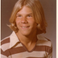
Introductions
Me:
PhD from Nova Southeastern University, 2013
Teaching at iSchool since 2018
Director of Analytics at Koyus, a company that manages cash inventories at retailers in US and Canada
Live in southeast Florida “hurricane alley”
Time permitting...
You: Say your name, where you are from, and one other thing about yourself, for example:
If you have a pet, like a dog or a cat
If you have an interesting travel destination or place you like to visit
If you are a musician or artist, what you play or do

Slide 7
Doing Good Pair Work in Breakout Groups
Navigator dictates the code. Can/should consult with driver for ideas and suggestions.
In most breakout groups, I will randomly pair you with another person in the class.
Get to know that person a bit. Share your story with them.
One person should be the driver and should share their R-Studio screen.
The other person should be the navigator. The navigator dictates code and comments.
Most classes have two breakouts. Try to switch roles.
Take your time and make sure that both people understand what is going on.
Driver runs the keyboard and the mouse. Listens to the navigator. Can comment and suggest.
A key goal of each breakout is to learn from each more: both mistakes and successes.
Credit: SolutionsIQ

Slide 8
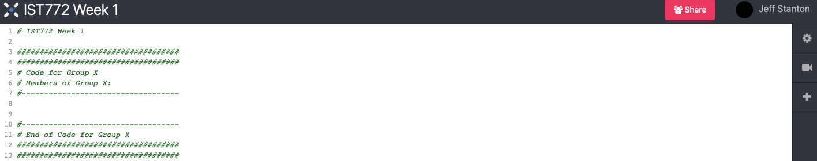
Code Sharing During Breakouts
Code is formatted as R code, but can’t be run from this window. Paste code from your local copy of R-Studio.
Create/use a space in the code share for your group’s code.

Slide 9
Breakout 1 – R-Studio Skills Checklist
This is not a class in how to program in R, but everything about the homework and tests will be easier if you have good R skills.
This breakout practices your use of each of the four major windows in R-Studio.
You will have an opportunity to begin the important habit of adding comments to your code files.
You will share your group’s code at the end for the benefit of your group members and other people in the class.

Slide 10
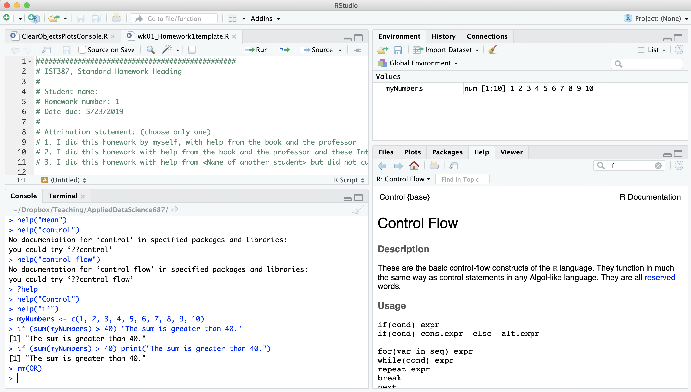
R-Studio Main Window Panes

Slide 11
Breakout 2 – Descriptive Statistics and Distributions
Calculate mean, var, sd on a small data set without using the functions for those calculations.
Answer two conceptual questions.
Examine a histogram and describe a quantile.
Generate three random distributions to fit a hypothetical research situation.
You will share your group’s code at the end for the benefit of your group members and other people in the class.

Slide 12
Plausible Distributions
Can you identify all three?

Slide 13
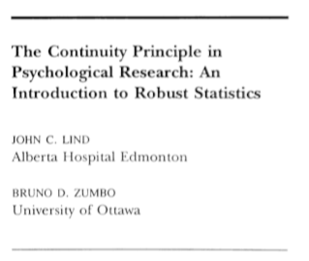
Paper of the Week – Lind & Zumbo, 2012
“Robust” statistics are less sensitive to outliers and distortions of normality
Estimators such Huber’s M-Estimator calculate means and standard deviations which, when replicated over many samples are more likely to be close to the population values
Try the huber( ) function in the MASS package: huber(iris$Sepal.Length)

Slide 14
Homework 1
Prepare your HW in MS-Word (or another word processor) or Markdown.
Snapshot the code from R-studio; provide the written explanation underneath the code; intersperse the appropriate output within the written explanation.
Use a monospace font, like Courier, for your code and output. Feel free to use that font for the whole file!
Please submit your HW as a PDF file. This greatly streamlines the grading process.
HW1: Problems 1, 3, and 4 on page 20 of the RwD textbook

